Slide 1

Bike Sales & Profit Overview Analysis
This dataset provides a comprehensive view of sales performance, combining customer segmentation, product profitability, pricing strategy, and geographic distribution.
Presented By:
Aishwarya Mahesh Daswant
Date:
12/13/2025

Slide 2

Problem Statement/Overview
A global bicycle manufacturer wants to understand sales performance across different products, countries, and customer segments. The company sells products like Carretera, Montana, Paseo, Velo, VTT, Amarilla, etc. Leadership needs insights into:
Which products are performing well.
Which segments (Government, Midmarket, Enterprise, etc.) contribute most to revenue country-wise sales and profit variations?
Seasonal trends by Month / Year
Profitability and cost efficiency across markets
Opportunities to optimize pricing and inventory
The Goal is to build an interactive Power BI dashboard that allows stakeholders to analyze sales, profit, COGS, discounts, and product performance.

Slide 3

Who will use this Dashboard ?
Primary Users
✔ Sales Managers – track product performance & regional sales ✔ Finance Team – analyze revenue, COGS, profit & margins ✔ Product Managers – compare product-level demand and profitability ✔ Executives / Directors – monitor overall sales KPIs
Secondary Users
✔ Marketing – understand market response by segment & country ✔ Supply Chain – forecast units sold & plan inventory

Slide 4
Data Overview
Gross Sales
127.93M+
Worked with a multi-dimensional business dataset incorporating customer segments, geographic regions, and discount bands to build interactive Power BI dashboards. Enabled performance comparison across markets, evaluated pricing strategies, and delivered actionable insights on sales, discounts, and profit margins.
Comprehensive Financial Metrics
Units Sold
Manufacturing Cost per Unit
Sale Price per Unit
Gross Sales (Units Sold × Sale Price)
Discounts Applied
Net Sales (after discounts)
COGS (Cost of Goods Sold)
Profit (Net Sales – COGS)
Product :
Carretera (Road)
Montana (Mountain)
Paseo (Hybrid/City)
Velo (Performance)
VTT (Off-road)
Amarilla (Sport/Hybrid)
Detailed Time Intelligence Fields
Transaction Date
Month Number
Month Name
Year
Net Sales
118.73M+
Total Profit
12.06M+
21%
Total Discount
9.21 M

Slide 5
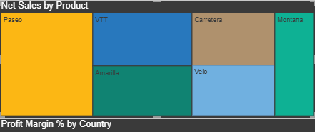
Analysis :
Analysis of Net Sales shows that VTT and Paseo contribute the majority of revenue, Montana performs moderately, and Carretera underperforms. Further segmentation by customer segment and region is recommended to analyze profitability. Strategies should focus on boosting Montana and Carretera sales while leveraging VTT’s strong performance.
.

Slide 6
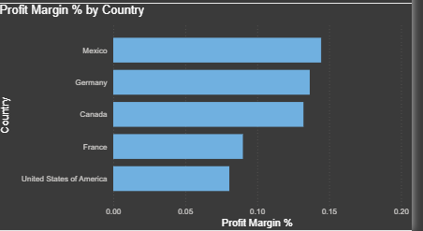
Analysis:
Mexico, Germany, and Canada deliver the highest profit margins, France shows moderate profitability, and the USA has the lowest margin, likely due to higher costs or competitive pressures.

Slide 7
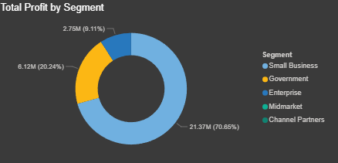
Analysis:
The business is performing well but relies heavily on the Enterprise segment, which accounts for 57% of profits. There is strong growth potential in Government (≈24% contribution) and Small Business, while Midmarket and Channel Partners require strategic review.
Segments | Profit in INR | Profit in %
1. Small Business | 21.37 M | 70.65%
2. Government | 6.12M | 20.24%
3. Enterprise | 2.75M | 9.11%

Slide 8
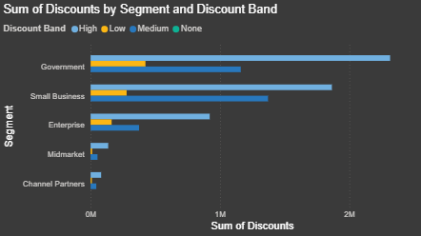
Analysis:
Discounting is concentrated in the Government and Small Business segments. The business should optimize discounts and enforce pricing governance in these segments while leveraging growth opportunities in low-discount markets like Midmarket and Channel Partners.

Slide 9
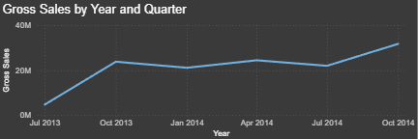
Analysis:
Q4 (October 2013 and 2014) is the strongest performing quarter.
Q1 and Q3 show comparatively weaker performance.
Sales growth is inconsistent, moving up and down across quarters.
This indicates dependency on seasonal trends or large one-time orders.

Slide 10
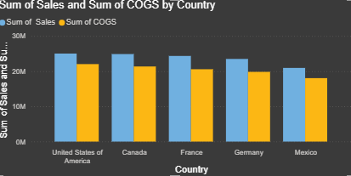
Analysis:
USA, Canada, and France are top revenue generators with strong margins.
Germany is stable but shows moderate growth.
Mexico underperforms due to smaller size, low penetration, and weak sales strategy.
Targeted strategies are needed to boost revenue in low-performing regions while sustaining high-performing markets.

Slide 11
Dax Measures Used
Name | Formula | Used
1. Average Manufacturing Price | Average Manufacturing Price = SUM('Sales Data 2013-2014'[Manufacturing Price]) | Helps determine the average cost structure. Average up all manufacturing prices in the dataset.
2. Average Sale Price | Average Sale Price = AVERAGE('Sales Data 2013-2014'[ Sales]) | Computes the average sale price per product transaction. Helps understand pricing strategy.
3. Gross Sales | Gross Sales = SUMX( 'Sales Data 2013-2014', 'Sales Data 2013-2014'[Units Sold] * 'Sales Data 2013-2014'[Sale Price] ) | Revenue before deducting discounts. SUMX evaluates each row → Units Sold × Sale Price → sums all rows.
4. Net Sales | Net Sales = SUMX('Sales Data 2013-2014',('Sales Data 2013-2014'[Units Sold] * 'Sales Data 2013-2014'[Sale Price]) - COALESCE('Sales Data 2013-2014'[Discounts], 0)) | Revenue after subtracting discounts. COALESCE() treats blank discounts as 0.
5. Profit Margin % | Profit Margin % = DIVIDE([Total Profit], [Net Sales]) | Percentage of profit from each currency unit of sales. Important for financial health.
Average
Manufacturing Price
169.61K
Total Units Sold
1.13M
Average Sale Price
169.61K
21%

Slide 12
Dax Measures Used
Name | Formula | Used
6. Top Selling Product | Top Selling Product = CALCULATE(VALUES('Sales Data 2013-2014'[Product]),TOPN(1, SUMMARIZE('Sales Data 2013-2014', 'Sales Data 2013-2014'[Product], "ProdSales", [Net Sales]), [Net Sales], DESC)) | Identifies the single product with highest Net Sales. Critical for Inventory planning Marketing decisions
7. Total COGS (Cost of Goods Sold) | Total COGS = SUMX('Sales Data 2013-2014','Sales Data 2013-2014'[Units Sold] * 'Sales Data 2013-2014'[Manufacturing Price]) | Total cost of producing sold units.. Essential for: Profit calculation Cost control analysis
8. Total Discount | Total Discount = SUM('Sales Data 2013-2014'[Discounts]) | Total discounts given across all sales. Helps analyze: Impact of promotional strategies Margin erosion due to discounts
9. Total Profit | Total Profit = [Net Sales]-[Total COGS] | Profit after deducting manufacturing cost. Used for: Country performance Product-line profit ranking
10. Total Units Sold | Total Units Sold = SUM('Sales Data 2013-2014'[Units Sold]) | Total units sold across all products. Useful for: Best-selling products Inventory forecasting
Top Selling Product
Paseo
Total COGS
106.66M
21%

Slide 13

Future Enhancement
Add sales forecasting and deeper drill-through insights for more targeted analysis
Incorporate customer segmentation to better understand performance across segments
Enhance discount and profitability analytics, including contribution margin and inventory metrics
Enable real-time data refresh for up-to-date insights
Improve user experience with interactive tooltips, bookmarks, and narrative insights to make the dashboard more dynamic and intuitive
.

Slide 14
Conclusion
The business demonstrates strong overall sales and profitability with steady growth. Paseo is the top-selling product, while the Small Business segment generates the highest profits. Regionally, Mexico and Germany achieve higher profit margins, whereas USA and Canada lead in sales but require cost control measures. Discounts primarily drive sales in the Government and Small Business segments, highlighting opportunities for optimization. Focusing on cost management and leveraging high-performing products and markets can further improve overall margins.

